Slide 1
Software Design and Architecture(SE:2002) Use-Case Domain Models
Course Instructor: Romasha Khurshid
Email Address: Romasha.Khurshid@nu.edu.pk
Reference Book: Applying UML and Patterns (An introduction to Object-Oriented Analysis and Design And Iterative Development)
BY Craig Larman
Third Edition
Notes:
1

Slide 2
Lab Task
There are Multiple Mobile Application available online on play store. Every Application developed for particular reason. Now a day’s one application getting more popularity as a Car service, named as “Careem Car”. Which is mostly use for picking up and drop off from the particular location. Careem is a vehicle for Hire Company which is a subsidiary of American company. It is based in Dubai, with operations in over 100 cities in 15 countries in the Middle East, Africa, and South Asia.
Before availing this service you have to download and install from a play store. It is basically a Mobile application so, this application can directly linked with you phones’ GPS services. You just have to open the application and create an account with your phone number, email id. Then you will get confirmation email or sms from application. After confirmation you are able to pick up a ride, but before using this. Application have two option one is use as a passenger or you want to be Careem Captain. If you selected Careem Captain, that means you have to fill the form, also select your training slot and you can train online or at our offices.
After completing your training, you will receive a confirmation SMS. Log in to portal and start earning. Once you complete the ride, your earnings will be updated on your Captain Portal. For some rides you can collect the cash from the customer, but for credit card and wallet based rides, Careem will pay for the ride. If you are using Careem as passenger. Then Select from a wide range of options and get a ride in minutes or schedule one for later. From the moment your Captain is assigned till you get to your destination, track your ride in real time or share your details with your loved
ones. Payment method for ride, you can use different options like if you want to pay as Cash, card, or Careem credits, there is also one option regarding feedback rating. After the happy ride there is option of 5 star rating. If you are satisfied with Captain behavior and ride, then you can rate a captain on Careem app. This feedback will help full for the captain.

Slide 3
i. Identify the actors of the system.
ii. What are the candidate use cases you can find?
iii. Design the Complete USE CASE diagram for given System.

Slide 4
Use-Case levels:
Use-case can be written in different levels of detail. For example:
Brief use case:
A few sentences summarizing the use-case, usually the main success scenario.
one during early requirements analysis
should take only a couple of minutes
Casual use-case: multiple paragraphs
often used in agile because they easy, quick to write and understandable for both customer and developer
Main success Scenario: A customer arrives at a checkout with items to return. The cashier uses the POS system to record each returned items.
Alternate Scenarios: if the customer paid by credit. If the item identifier is not found in the system. If the system detects failure to communicate with the external accounting system .
3. Fully Dressed use case:
A carefully structured and detailed description enabling a deep understanding of the goals, tasks, and requirements. Used when system is complex and has high risks.

Slide 5
Detailed/Descriptive/Fully-Dressed Use-Case
Elements of a Use Case:
Use Case Name - Brief description. (Start with a verb)
Primary Actor – anyone or anything that performs a behavior (who is using the system)
Secondary Actor/ stakeholder– stakeholder who cares about this use-case.
Preconditions – what must be true or happen before and after the use case runs.
Post-Conditions - A list of conditions that must be true when the Use Case ends.
Triggers – this is the event that causes the use case to be initiated.
Main success scenarios [Basic Flow] – use case in which nothing goes wrong.
Extensions/Alternative flow – these paths are a variation on the main theme. These exceptions are what happen when things go wrong at the system level
Exception- Exception is anything that leads to NOT achieving the use case's goal. .
Quality- Specify quality attribute.

Slide 6
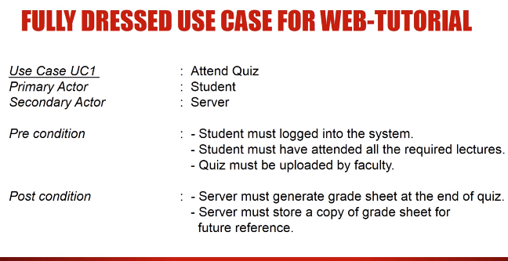

Slide 7
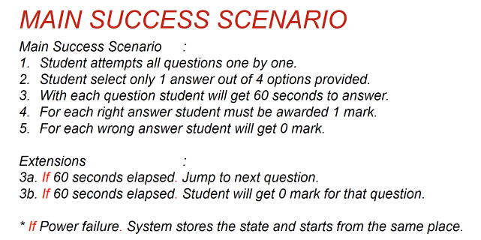

Slide 8
Exercise…
An executive at a chain of family restaurants called Brampton's Pizza
and Pasta.
They are looking to develop some software for in-house use at their restaurants.
Their goal is to take the restaurant ordering process and make it more efficient.
She is thinking that customers should be able to view the menu of the restaurant they're
in, and once they're ready, place an order.
she'd really like there to be a kids' page where you can see the kids' menu.
Maybe there's a few games for the kids to play, but most importantly,
it should be easy enough to use that kids can make an order themselves.
customers should also be able to specify any changes they'd like to make
for their meal, and they should be able to list any dietary restrictions they may
have before they submit their order to the kitchen.
The kitchen should then be able to view these orders as they come in.
Customers should be able to view and pay their bill within the system.

Slide 9
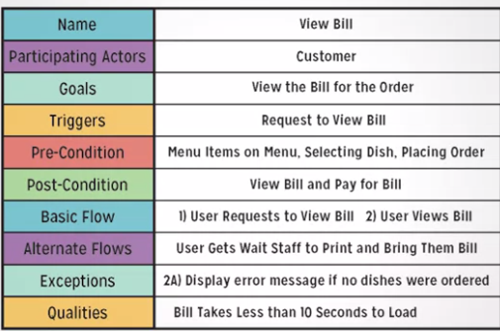
Solution…

Slide 10
Exercise…. Write a narrative Use case for “booking a flight” using UACAir app.:
UACAir allows passenger to select their domestic travel route. On entering their departure city, UACAir app populates options of arrival cities accordingly.
This tab takes departure and arrival airport details and then asks the passenger the number of adult and child tickets, if it’s a round trip or one way trip.
If it’s a round way trip, the passenger then selects the departure and return dates. (UACAir throws error if return date is smaller than departure date).
On pressing ok, all available flight schedules and details including airline details, price, departure and arrival date time along with a confirmation button is shown.
The passenger then choose his desired flight(s).
The passenger then enters all passengers’ details based on the number of tickets chosen.
The confirmation button, UACAir app redirects passenger to payment section for the ticket(s) purchase. UACAir only accepts payment through credit/debit card.
Once the payment has been done the itinerary will appear on UACAir my itinerary tab with the travel plan details. The passenger can view their itinerary and itinerary will remain there till the travelled date and time has passed.

Slide 11
Draw a Domain Model of given scenario:
FAST maintains a record of all the students and offers courses. Well-defined syllabus
is maintained for all the courses with a predefined list of subjects that are offered in each semester. Students are allowed to enroll in five courses each semester. Instructors in the FAST are assigned courses to teach, three courses according to the area that is specialized in and their availability. The students are allowed to take an exam for all the regular subjects offered in a specific semester. FAST prepares transcripts of the students based on the grades of all the subjects in which students appeared for the exam. Any student having greater than four backlogs in a year is detained and cannot appear for regular subjects in the next one year. There is a group of Course Administrators in the FAST to manage the courses including course content, assign courses to instructors and define the course schedule.
Notes:
11

Slide 12
Domain Models
Key object-oriented analysis step: Decompose domain into noteworthy concepts or objects
UML class diagrams used to draw domain models
Conceptual perspective. Shows:
Domain objects (conceptual classes)
Associations between domain objects
Attributes of conceptual classes
Domain model is NOT a model of software objects or our design
The following should NOT be in a domain model
Software artifacts: Window, database, …
Responsibilities or methods
Notes:
12

Slide 13
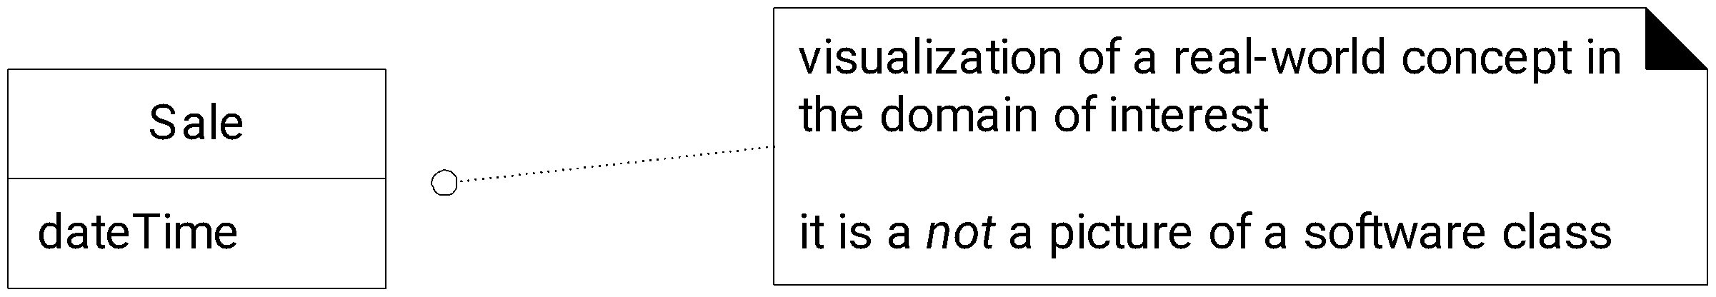
Fig. 9.3
Notes:
13

Slide 14
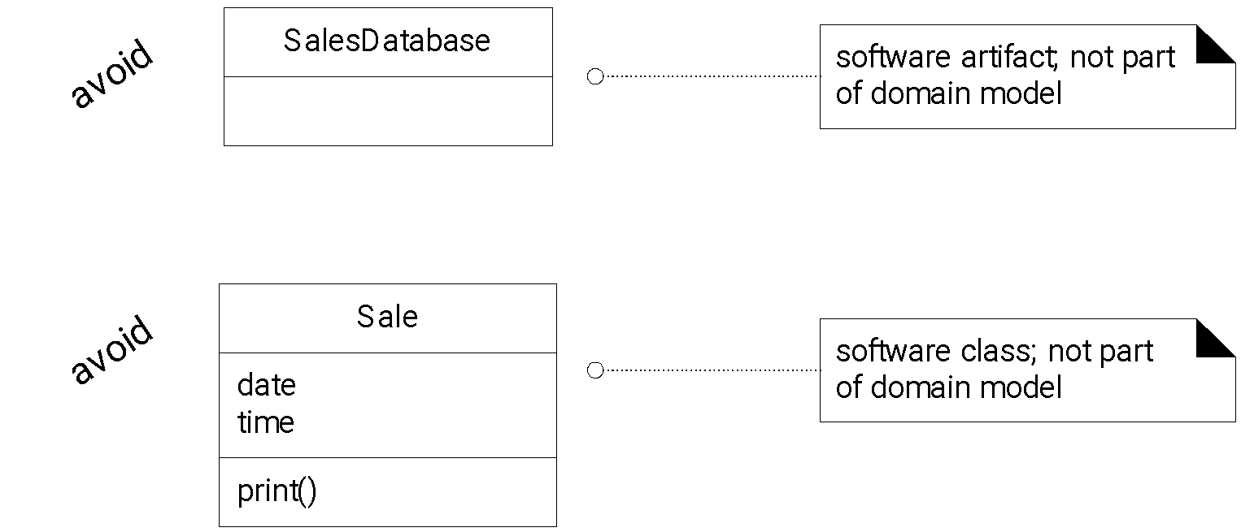
Fig. 9.4
Notes:
14

Slide 15
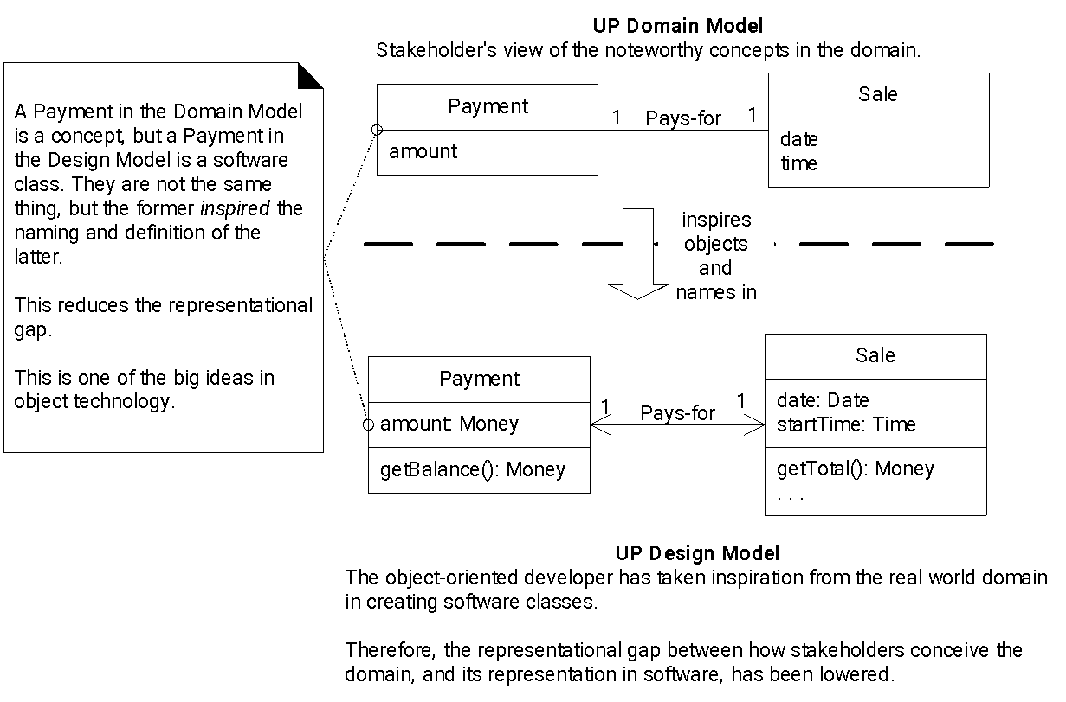
Software Class Names Inspired by Domain Model Objects
Notes:
15

Slide 16
How to create a domain model?
Find conceptual classes
How?
Re-use or modify existing models
Use a category list
Identify noun phrases
More on these later
Draw them as classes in a UML class diagram
Add associations and attributes
More on this later
Notes:
16

Slide 17
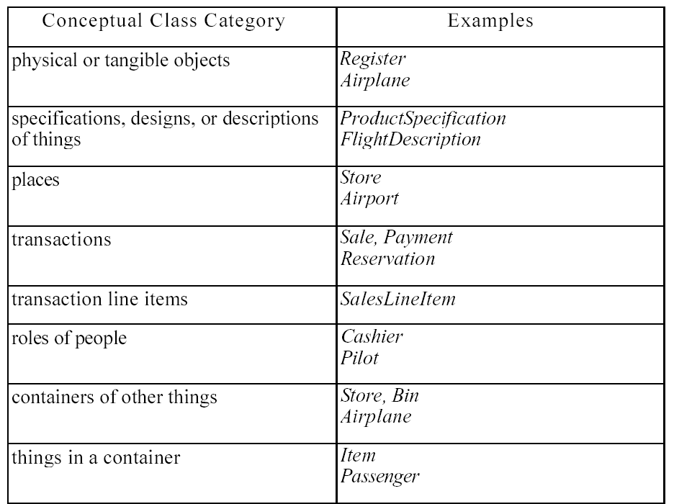
Notes:
17

Slide 18
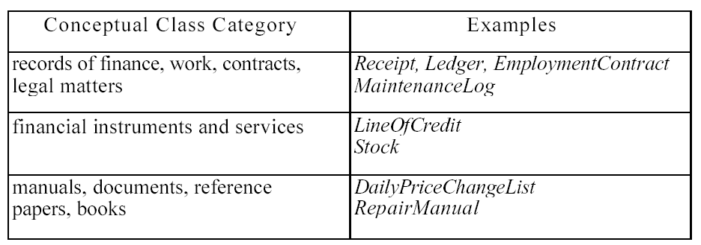
Notes:
18

Slide 19
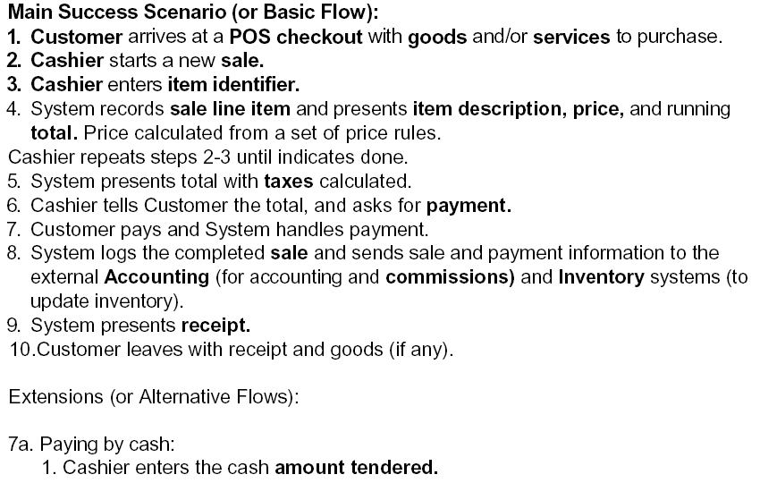

Identifying nouns as candidates for domain objects
Notes:
19

Slide 20
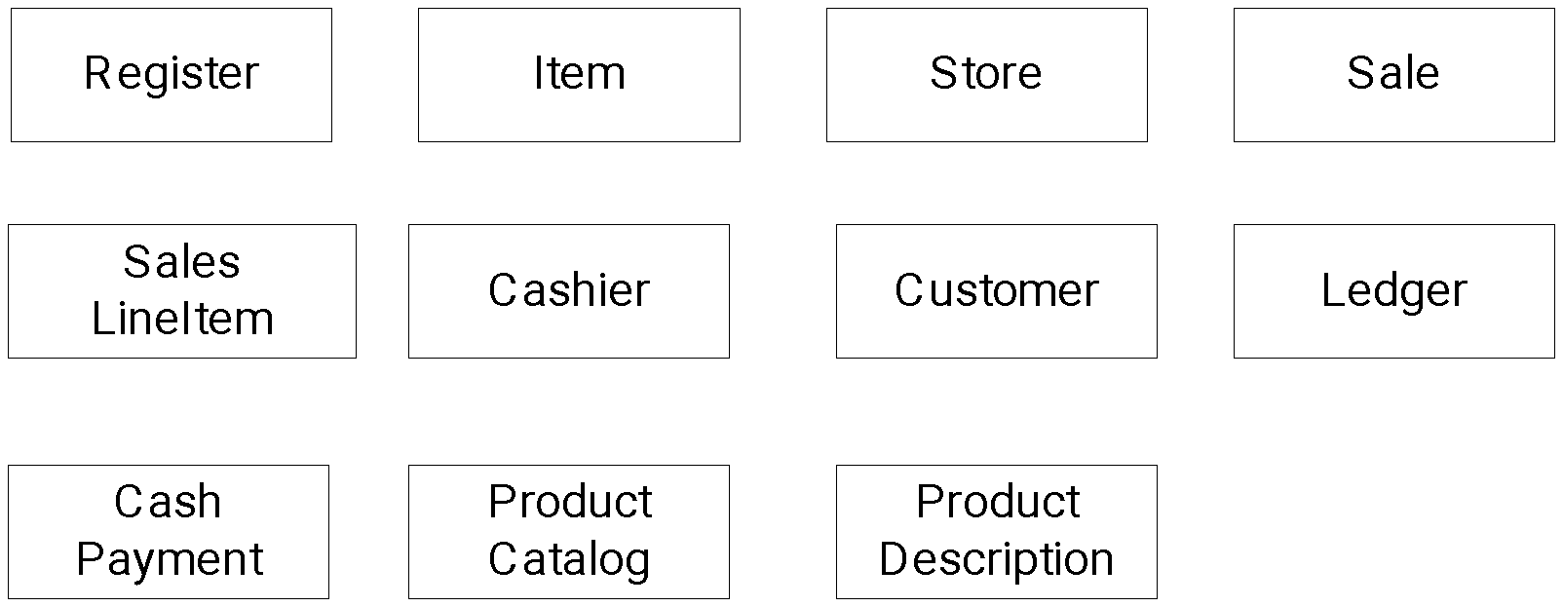
Candidate Conceptual Classes: Process Sale, Iteration 1
Notes:
20

Slide 21
Attributes vs. Classes
Should “something” be
an attribute of a class, or
a separate conceptual class
Examples:
Store: An attribute of Sale or separate class
Store: Not a number or text
Should be separate conceptual class
Flight destination: An attribute or a separate class
Destination is an airport, not a number
Should be separate conceptual class
Guideline:
If we thing of something as simply a number or text in real life, it should be an attribute.
Otherwise it should be a conceptual class.
Notes:
21

Slide 22
“Description” Classes
A description class contains information that describes something else
Example: ProductDescription
Records price, picture and text description of an item
Why use them? Why not include all that information in the Product class?
We need this information stored and represented even though there are no objects of that particular product type.
Don’t want to duplicate product information for each duplicate product object
Serial number belongs with product object
Picture of product belongs with product description
Need objects that are “specifications” or “descriptions” of other objects
Notes:
22

Slide 23
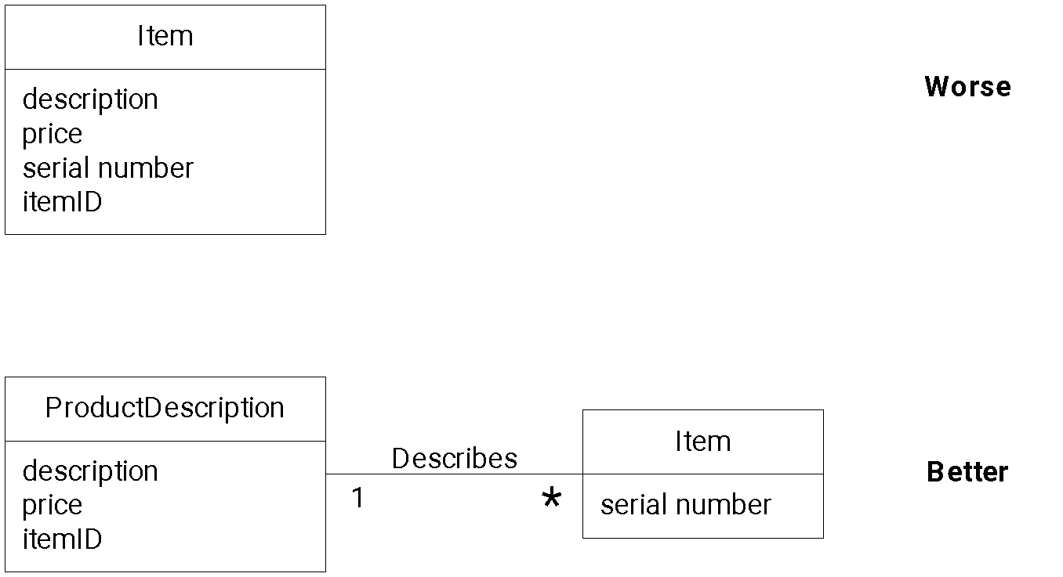
Description class example
Notes:
23

Slide 24
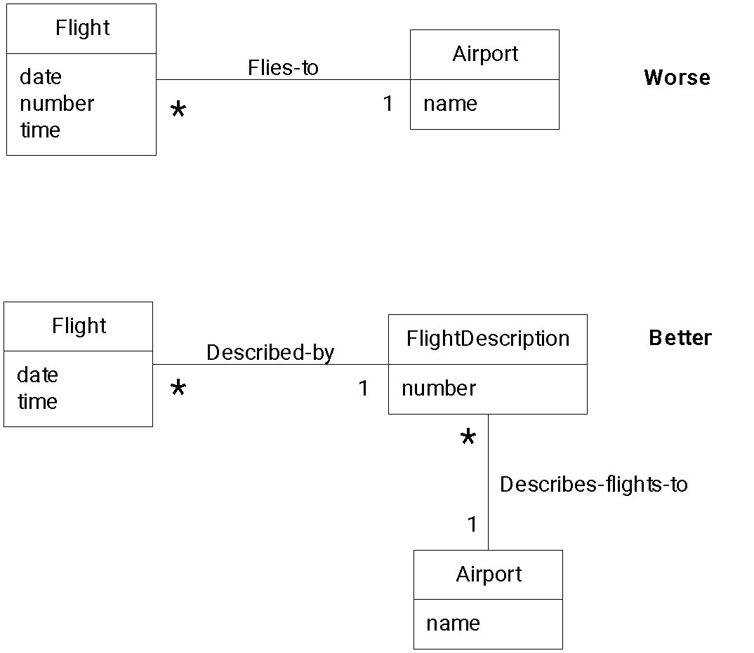
Description class example
Even when that flight is not scheduled that day, the flight description exists.
Notes:
24

Slide 25
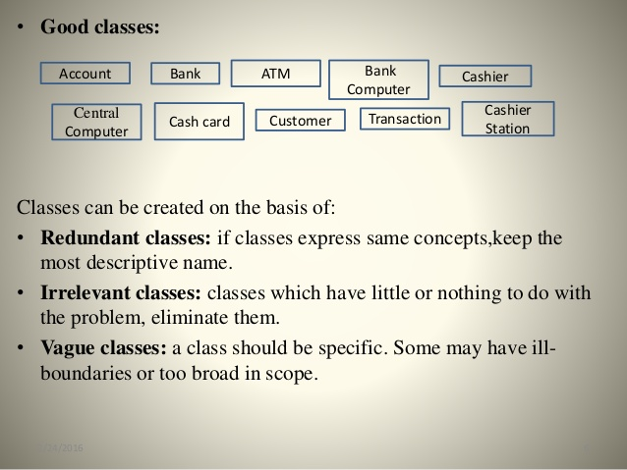
Something more on classes….

Slide 26
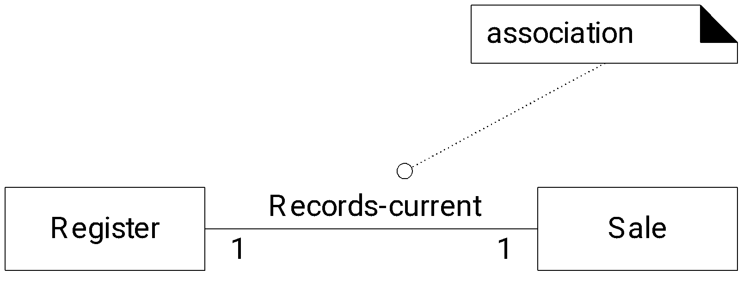
Associations
Association: A relationship between (instances of) classes that indicates some meaningful and interesting connection.
Used to show relationships that need to be remembered and preserved for some duration
Notes:
26

Slide 27
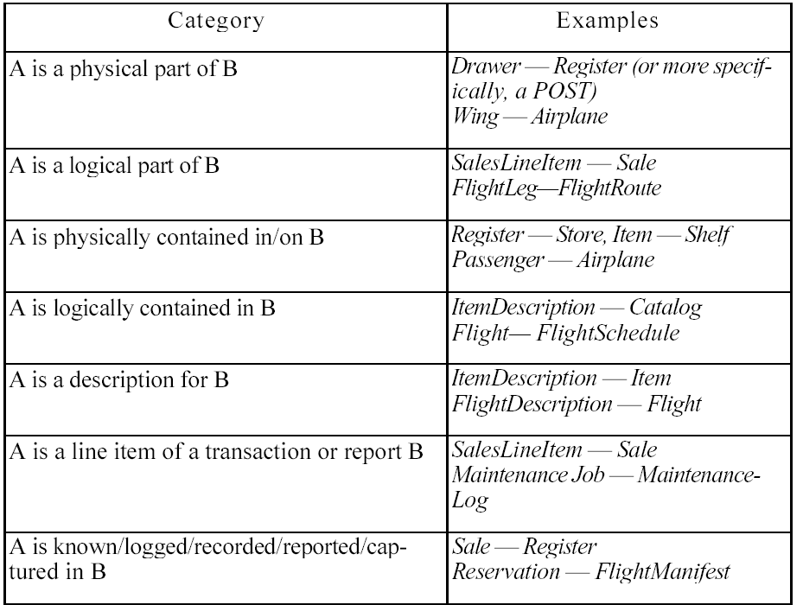
Common Associations List (i)
Notes:
27

Slide 28
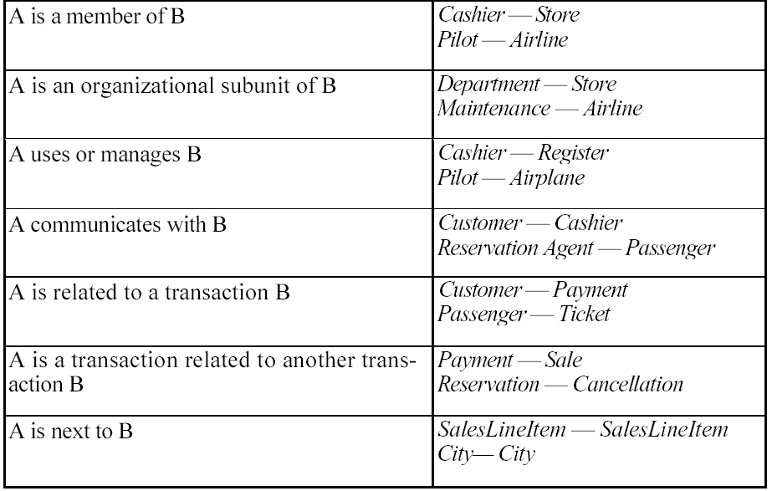
Common Associations List (ii)
Notes:
28

Slide 29
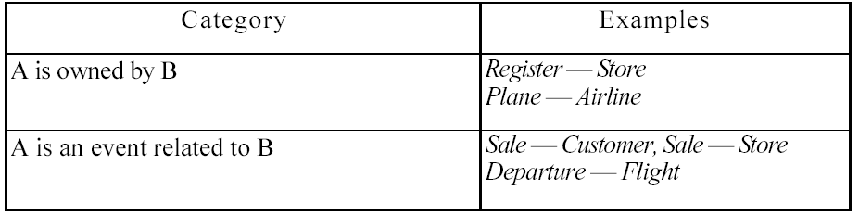
Common Associations List (iii)
Notes:
29

Slide 30
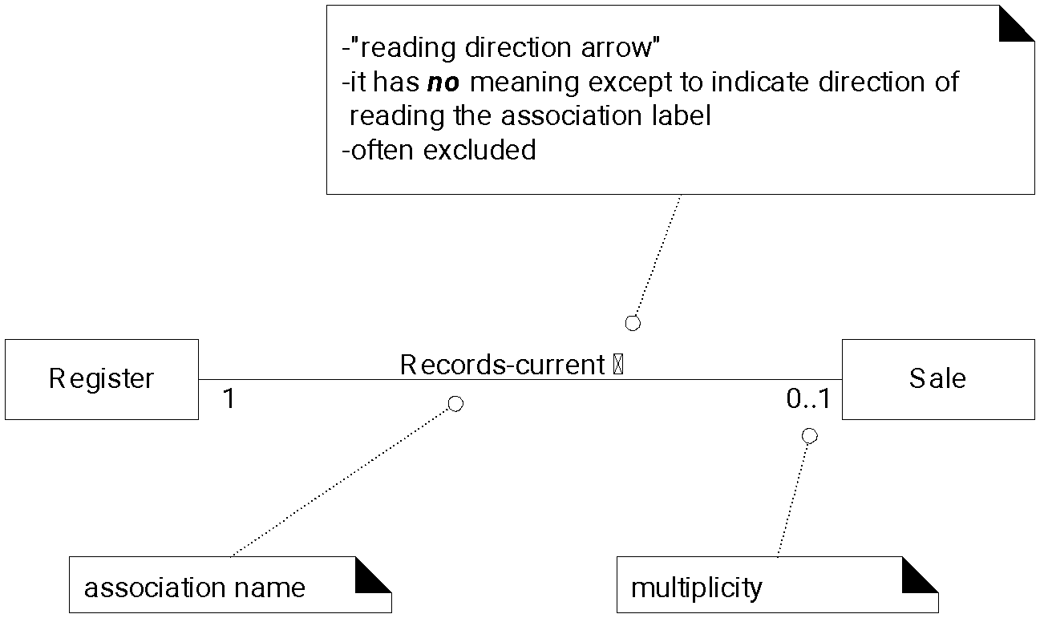
Association Directionalities
Notes:
30

Slide 31
How to name an association?
Pattern:
Class name – verb phrase – class name
Readable and meaningful
Try to avoid “has” or “uses”. These give no extra information
Notes:
31

Slide 32
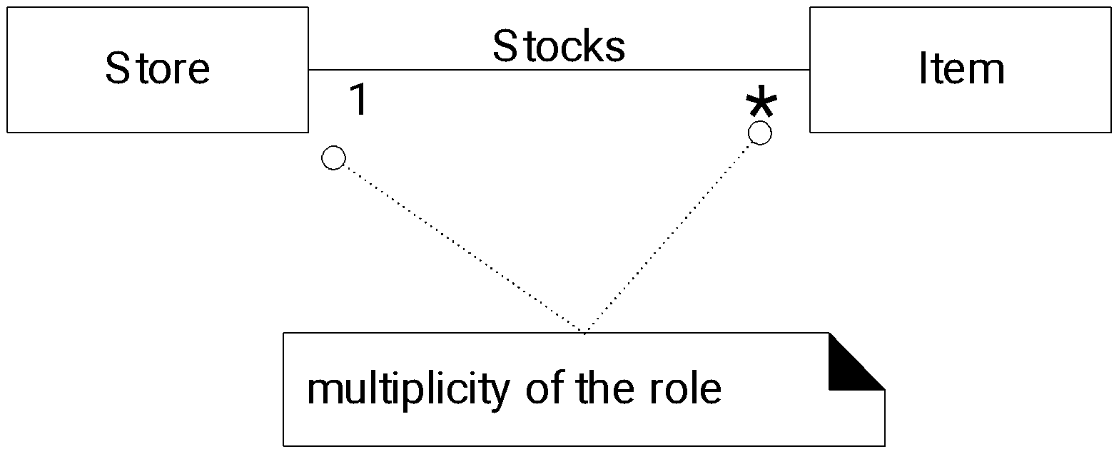
Association Multiplicities
Notes:
32

Slide 33
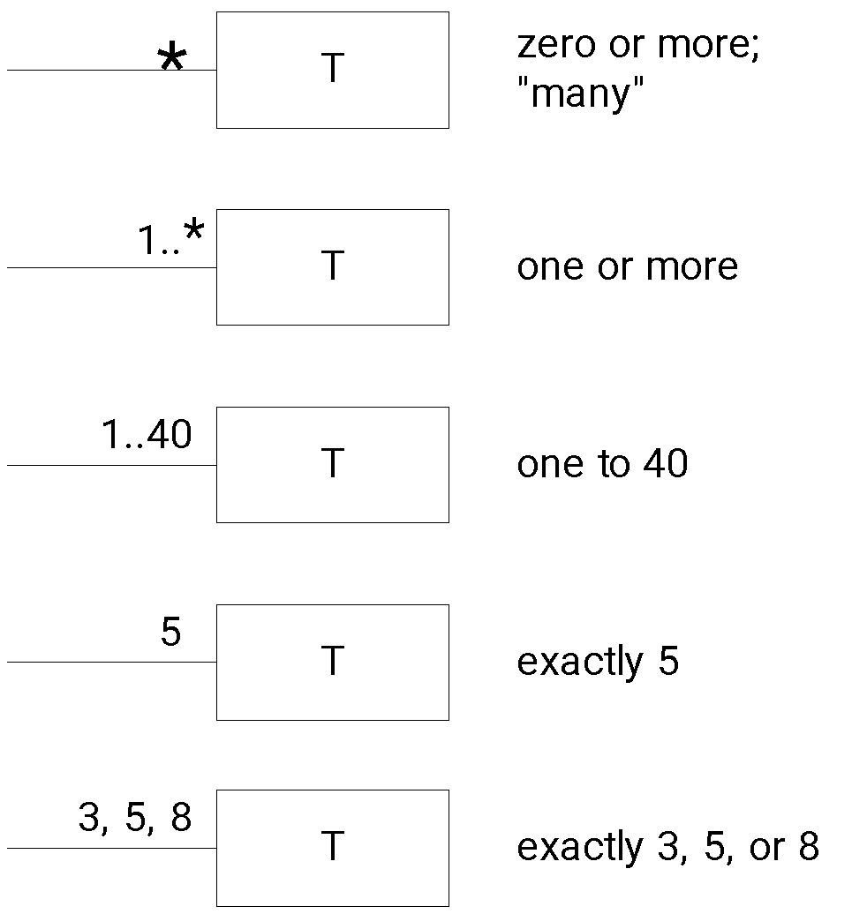
Multiplicities
Notes:
33

Slide 34
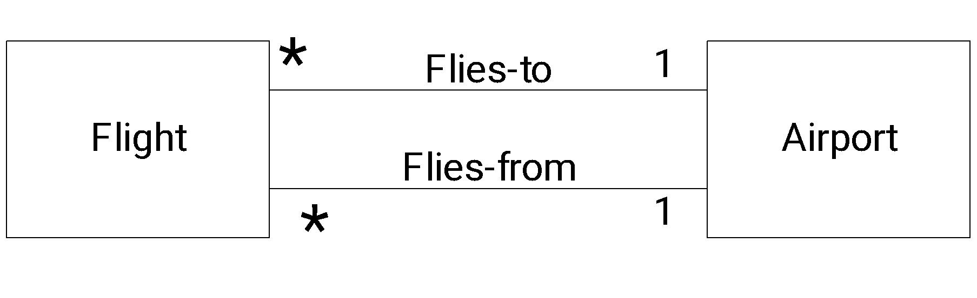
Multiple Associations
Notes:
34

